Slide 1
Pleural effusion
Prepared by: Mr. Sajid khan
Lecturer Surgical
INU Peshawar

Slide 2
Pleural effusion
It is the accumulation of excess fluid within the visceral and parietal layers of the pleura
Normal amount 8.4 ml per hemi thorax.

Slide 3
Location of effusion-amount of fluid
  75 mL-subpulmonic space without spillover, can obliterate the posterior costophrenic sulcus,
  175 mL is necessary to obscure the lateral costophrenic sulcus on an upright chest radiograph
  500 mL will obscure the diaphragmatic contour on an upright chest radiograph;
  1000 ml of effusion reaches the level of the fourth anterior rib,
  On decubitus radiographs and CT scans, less than 10 mL, and possibly as little as 2 mL, can be identified

Slide 4
Causes of pleural effusion
There are a number of many causes of pleural effusion.
Infection
Subphrenic abscess
Malignant neoplasm.
Cardiac failure
Pulmonary infarction
Collagen vascular diseases

Slide 5
Infection
Pleural effusions due to pneumonia are, on the whole, small and the pneumonia is usually the dominant feature on the chest film. Large loculated effusions in association with pneumonia often indicate empyema formation.
In some cases of tuberculosis the effusion is the only visible abnormality and the effusion may be large

Slide 6
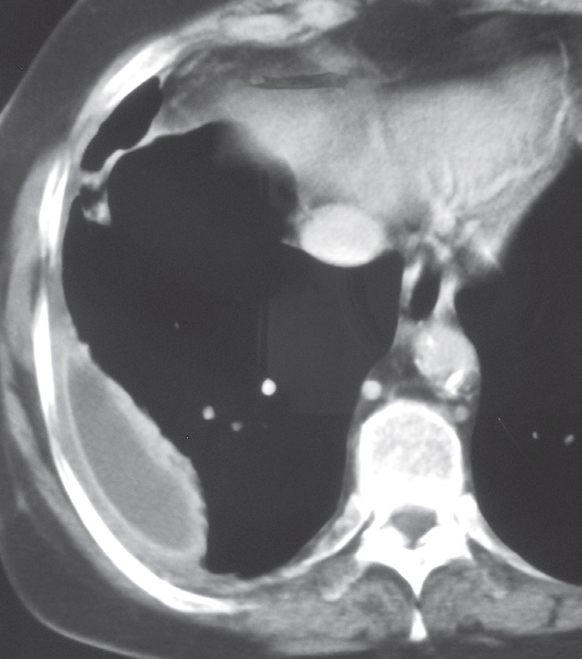
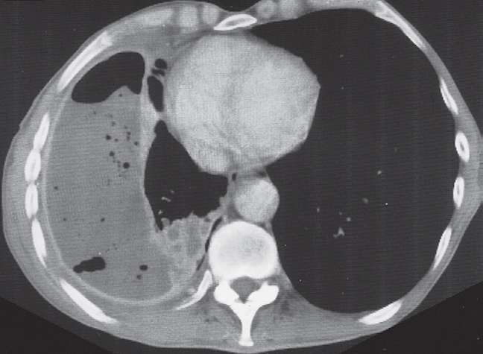
Empyema. (a) CT showing a typical lens-shaped pleural fluid collection with a clearly marginated wall consisting of thickened pleura. (b) CT showing multiple loculated air collections within the pus.

Slide 7
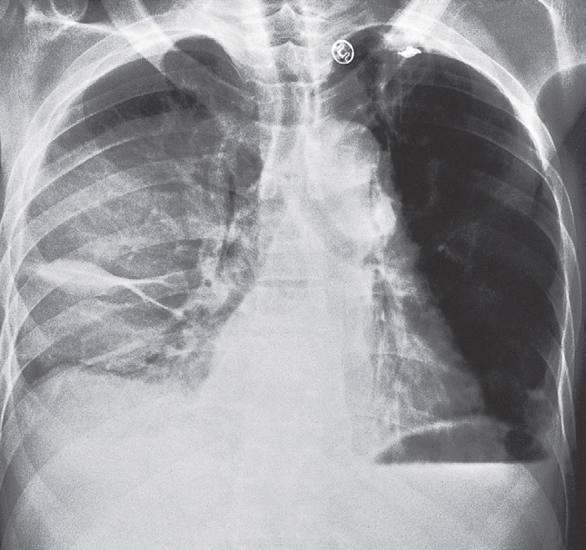
Loculated pleural fluid (empyema). (a) Plain chest film showing the fluid loculated in the horizontal (minor) fissure

Slide 8
Subphrenic abscess, which is nearly always accompanied by a pleural effusion.
Malignant neoplasm. Effusions occur with pleural metastases, but it is unusual to see the pleural deposits themselves on CXRs. Pleural metastases are occasionally seen on CT, MRI or ultrasound as nodular or mass-like pleural thickening. Malignant effusions are frequently large

Slide 9
Cardiac failure. Small bilateral pleural effusions are seen frequently in acute left ventricular failure. Larger pleural effusions may be present in longstanding congestive cardiac failure. The effusions are usually bilateral, often larger on the right than the left.

Slide 10
Pulmonary infarction. Pulmonary emboli that result in pulmonary infarction may cause pleural effusion

Slide 11
Plain radiographic findings
The radiographic appearances of fluid in the pleural cavity are the same regardless of whether the fluid is a transudate, an exudates, pus or blood

Slide 12
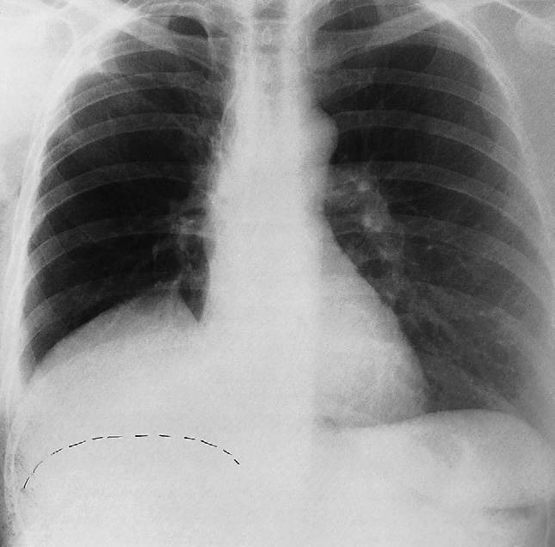
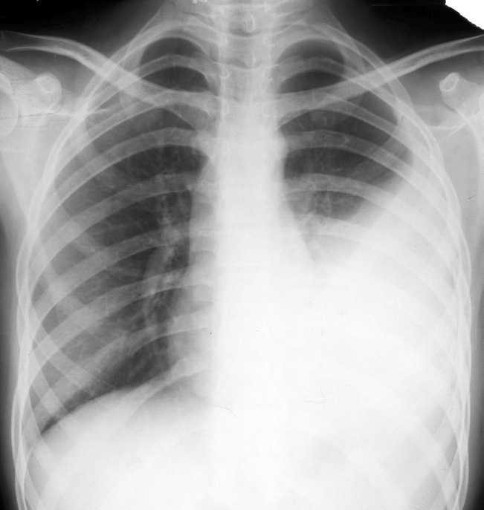
a. Large right subpulmonary effusion. B Large left pleural effusion

Slide 13
Free fluid collects in the most dependent portion of the pleural cavity and always fills in the costophrenic angles. Usually the fluid surrounds the lung and is higher laterally than medially. Very large effusions run over the top of the lung.

Slide 14
Sometimes, even with a large effusion, little or no fluid is seen running up the chest wall. The fluid is then known as a ‘sub pulmonary effusion

Slide 15
Ultrasound
Ultrasound is a simple method of determining whether pleural fluid is present. Pleural fluid can be recognized as a hypo echoic area between the lung and diaphragm or between the chest wall and the lung

Slide 16
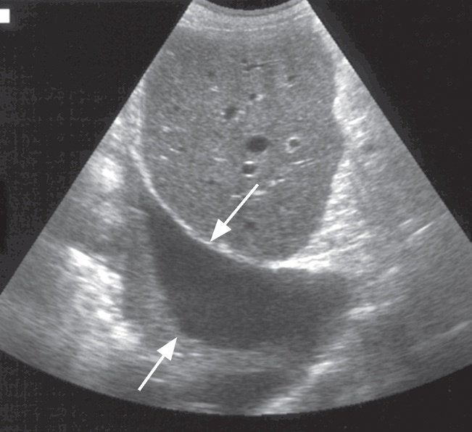
Ultrasound, sagittal image. The pleural effusion is seen as a transonic area between the diaphragm (downward pointing arrow) and adjacent lung (upward pointing arrow

Slide 17
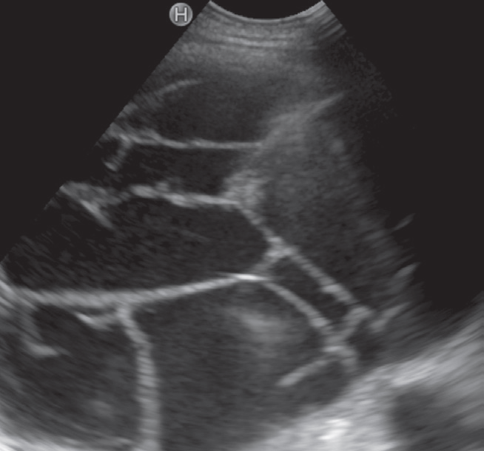
Chest ultrasound in a different patient, demonstrating multiple septations (arrows) within the pleural fluid. (

Slide 18
Computed tomography
Pleural effusions are usually seen as an area of homogeneous fluid density between the chest wall and lung .CT is particularly useful for showing loculated
pleural effusions If the fluid is due to recent hemorrhage it will show the high density of blood, otherwise it is not possible to determine the nature of the fluid

Slide 19
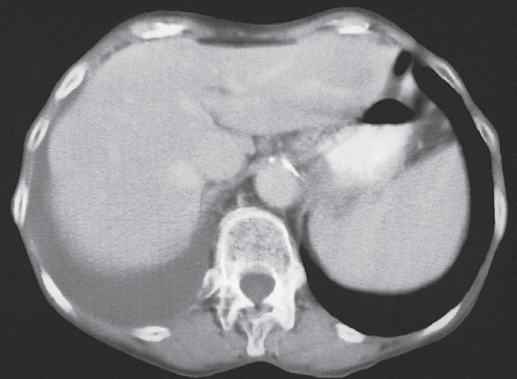
Pleural effusion. (a) CT. The section is taken through the lowermost portion of the pleural cavity

Slide 20
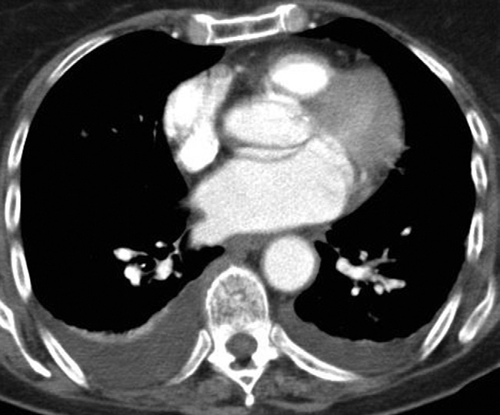
CT of pleural fluid. The bilateral pleural effusions are of homogeneous density

Slide 21
Thank you

